Slide 1
File Sharing Application
Team Members:
Patrick Jacobs, Haowen Yin, Ly Hoang Rivera, Dani Yap, Beize Li

Slide 2

Language: Java
Example message:
public class JoinMessage implements Serializable {
private final int port;
public JoinMessage(int port) {
this.port = port;
}
public int getPort() {
return port;
}
}
Socket
ObjectInputStream & ObjectOutputStream

Slide 3
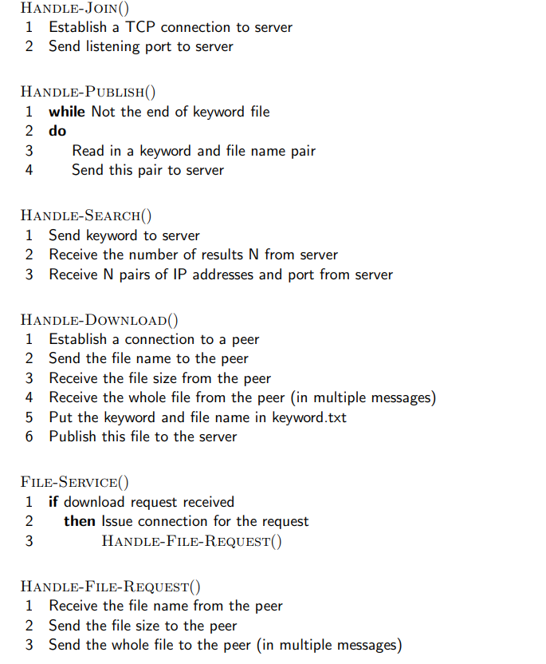
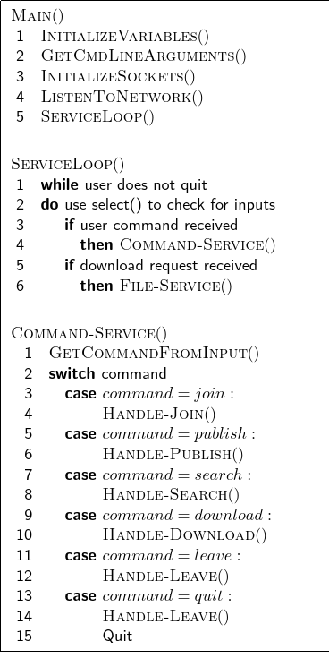
Architecture: Client

Slide 4
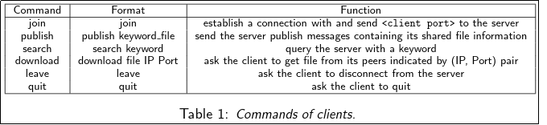
Architecture: Client Commands

Slide 5
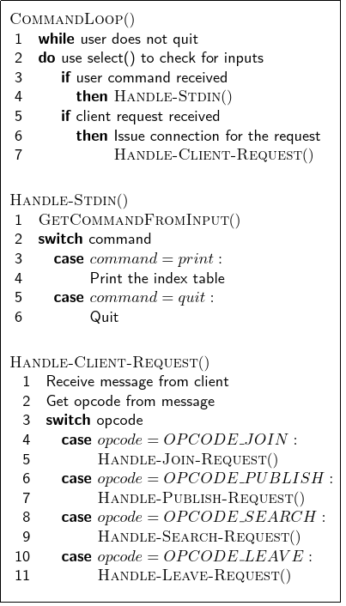
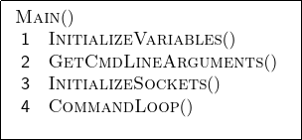
Architecture: Server

Slide 6
Timeline
April 13, 2022 - Simple connect between server and client
April 20, 2022 - Server provides peer information
April 27, 2022 - Able to download from peers
May 4, 2022 - Publish/join server as a peer.
May 11, 2022 - Search file on server

Slide 7
References
https://inst.eecs.berkeley.edu/~ee122/fa04/project/proj1/

